Slide 1
Poster Design

Slide 2
Design Principle – Poster Design
When designing a poster, there are some basic principles to use in order to present your information as clearly as possible.

Slide 3
Consistent Font
Use just one or two different fonts to keep the appearance uniform and easy to read. Font variety can be achieved by using the BOLD, ITALIC and UNDERLINE choices on the font toolbar. Sans serif fonts, such as Arial, are preferred for reading from a distance.

Slide 4
Consistent Colors
A color scheme of one or two colors helps to emphasize the information in the poster; the use of many colors may distract from the information you are presenting.

Slide 5
Consistent Alignment
Align the text boxes and illustrations in the poster by using guides in order to make the poster easy to navigate when seeing it for the first time. It is a good idea to recheck alignment after completing the poster, as well as running the spell check tool.

Slide 6
Self-Contained
A poster should be self-contained, self-explanatory and designed to allow several viewers to view it simultaneously.

Slide 7
Viewed from a Distance
The narrative text should be minimized into short, separated paragraphs using a large typeface.
Figures should be designed to be seen from a distance and should have clear visible graphics with large typeface.

Slide 8
Backgrounds
The best legibility is achieved by using black text on white backgrounds. Backgrounds made of dark images or texture patterns can cause the text to be obscured.
If you use different colors for text, avoid using yellow or other light colors as these are especially difficult to read.

Slide 9
Final Assignment: Poster Design – pick one from below themes Due: 24 May, 2023
Literacy Poster: Learn to Read
Event Promotion Poster
Contemporary Chinese Youth
Animal Rights

Slide 10
Requirements:
Size: A4
Orientation: landscape
Format: jpeg
Dpi: 150
Quantity: 1 piece
Color: full color
To apply the theory of visual hierarchy is a Must

Slide 11

What/Who/When/Where – Event Promotion Poster
Topic
Introduction (Abstract)
Target Audience
Date/Time
Location

Slide 12

What/Who/When/Where – Event Promotion Poster
Topic
Introduction (Abstract)
Target Audience
Date/Time
Location

Slide 13

What/Who/When/Where
Topic
Introduction (Abstract)
Target Audience
Date/Time
Location

Slide 14
Event Promotion Poster
You are to design an event promotion poster for an actual event that is happening at UIC. Use the actual information from the event you choose to layout in your design.
Media: Photographs, digital illustration and typography

Slide 15
Literacy Poster: Learn to Read
Media: Photographs, digital illustration and typography
Suggested Copy: “Read”, “Learn to Read”, Literacy First”

Slide 16

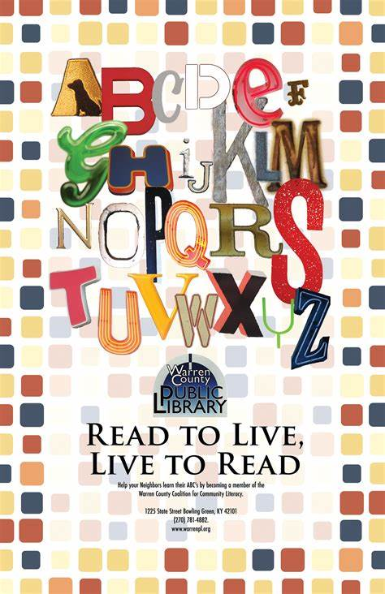

Samples

Slide 17
Contemporary Chinese Youth
Media: Photographs, digital illustration and typography
Suggested Copy: Open- minded, forward thinking….

Slide 18
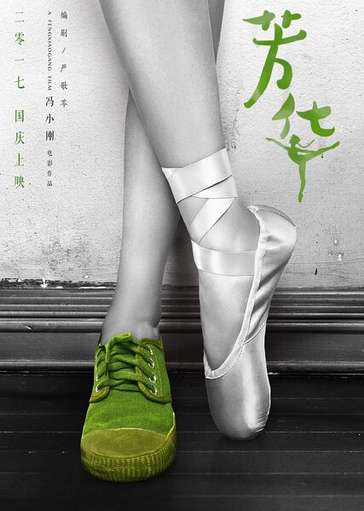
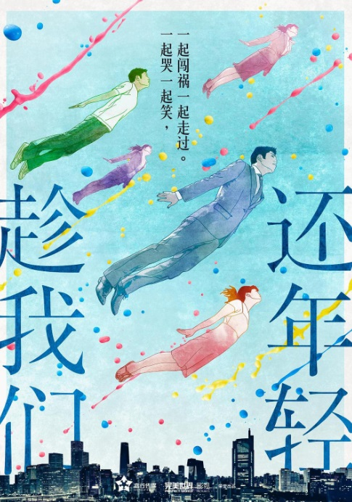
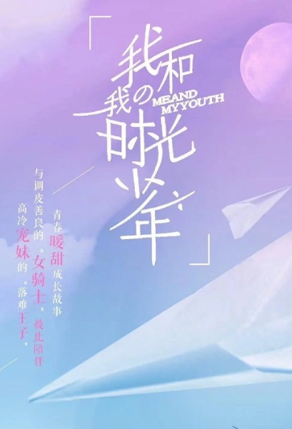
Contemporary Chinese Youth

Slide 19
Animal Rights
Media: Photographs, digital illustration and typography
Suggested Copy: Respect, protect…

Slide 20


Animal Rights

